Slide 1


MSAR TEAM
Project name
NUTRITION APP FOR HYPERTENSION ,HYPOTENSION AND DIABETICS.
Team members
Malak Hany Rawan Nasser
Steven Hany Salma Bahaa
Ahmed Abdelsattar Salma Ahmed
Group code
CAI2_DRT2_S3
Training company
YAT learning center

Slide 2
BRIEF
Problem Statement:
Individuals with hypertension, hypotension, or diabetes face daily challenges in managing their health, such as adhering to strict dietary guidelines, tracking food intake, and maintaining balanced nutrition. The main challenges include:
Tracking Nutritional Intake: Difficulty in monitoring calorie consumption, sodium levels, and blood sugar levels.
Personalized Guidance: The need for customized dietary advice tailored to different health conditions.
Ease of Use: A requirement for a user-friendly app that caters to people aged 10 to 60 without overwhelming them with complex information.
Proposed Solution:
The app provides an easy-to-use platform designed to help users manage their health effectively through:
Calorie and Nutrient Tracker: A comprehensive tracker for calories and essential nutrients to ensure users stay within their recommended limits.
Personalized Nutrition Plans: Tailored meal recommendations based on the user’s health condition, goals, and dietary preferences.
Intuitive Interface: A simple and clear design that makes navigation easy and presents health data in an understandable format.
Reminders and Alerts: Notifications to remind users of meals, medications, and hydration, as well as alerts when they reach their health goals.

Slide 3
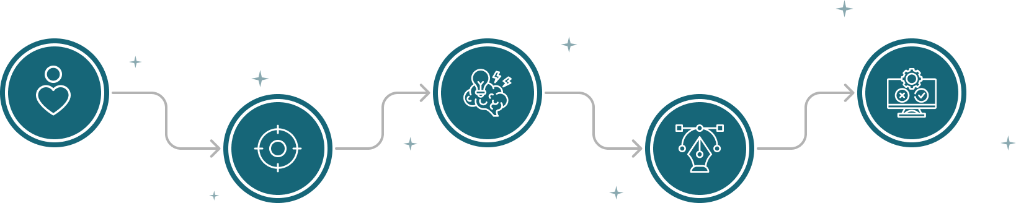
OUR PROCESS
Emparhize
Ideate
User research
Define
Brainstorming
Design
Interviews
User flow
Survey
User Persona
Wireframes
Competitive analysis
Problem statement
User journey map
Identify pain points
Problem statement
Set goals

Slide 4
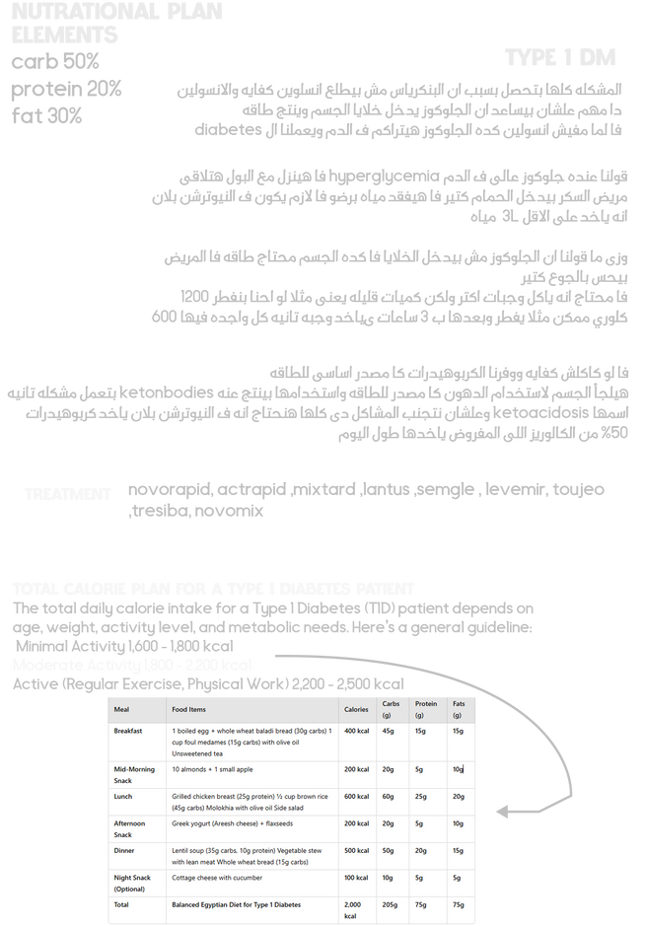
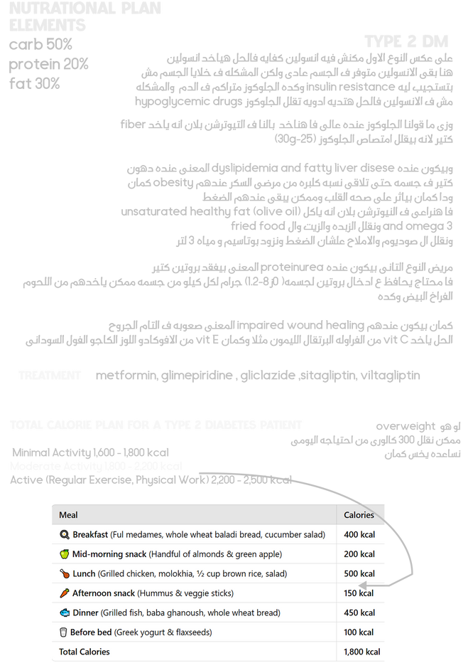
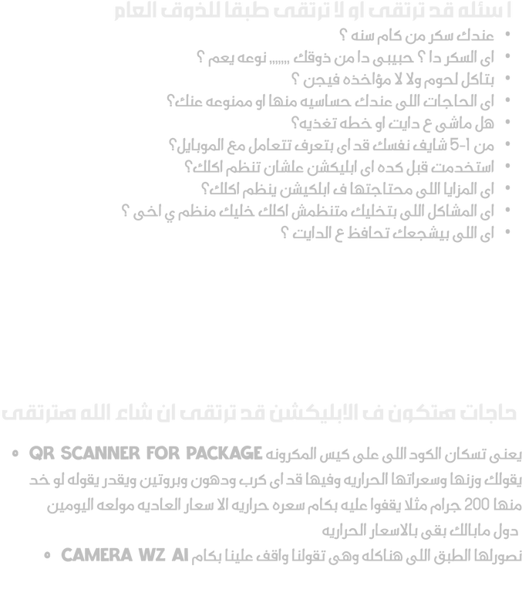
RESEARCH

Slide 5
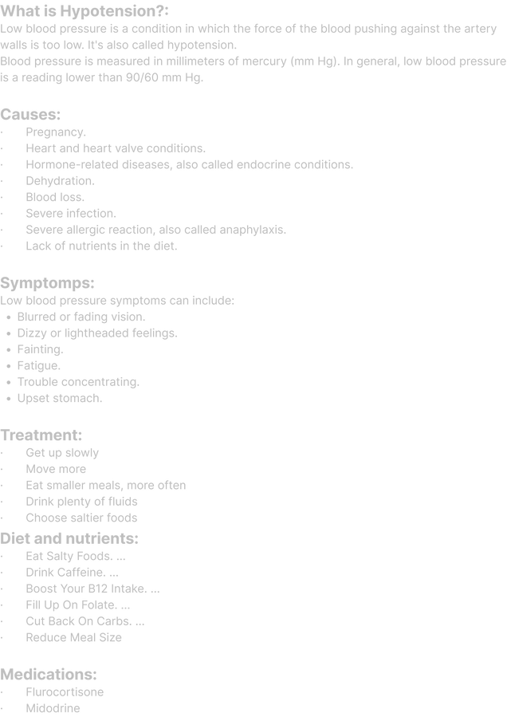
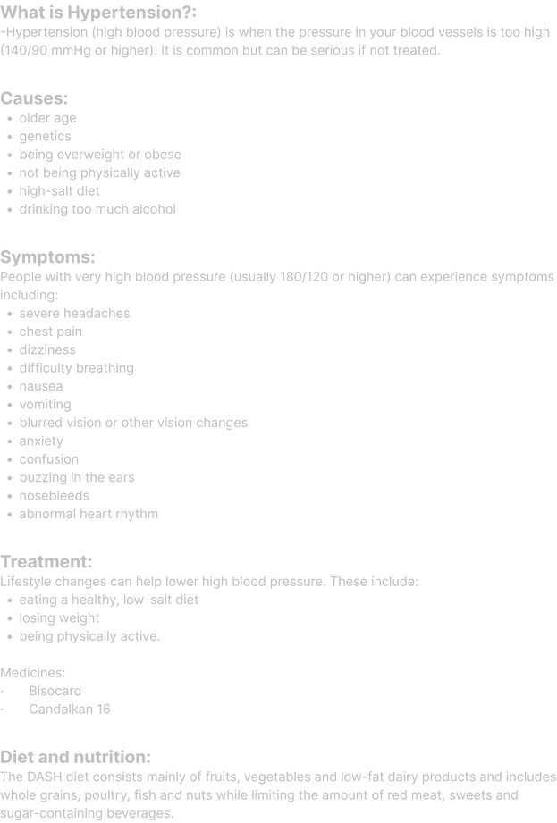
RESEARCH

Slide 6
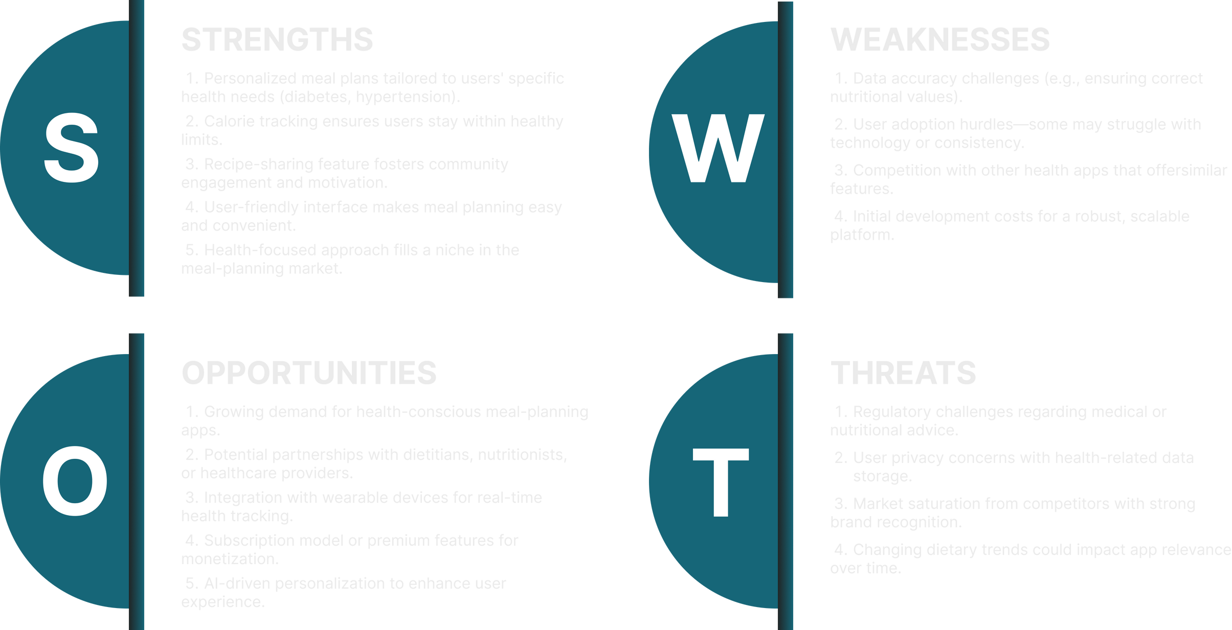
SWOT analysis

Slide 7
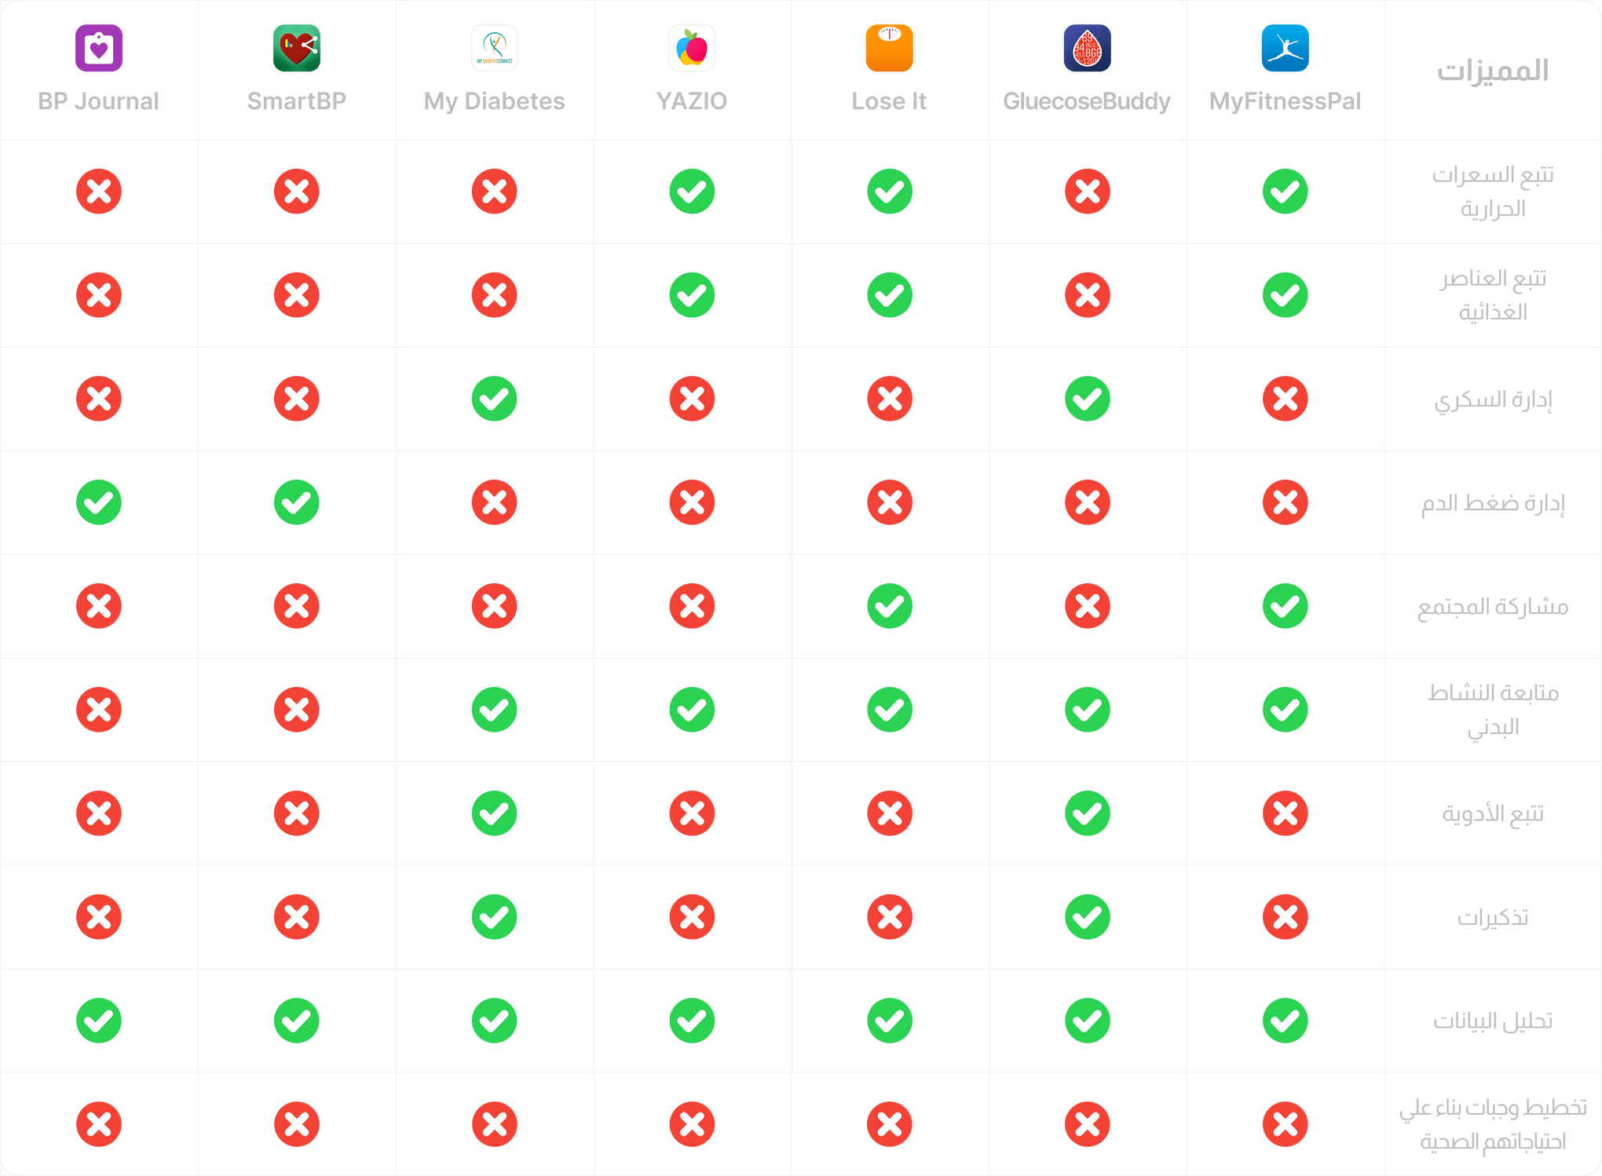
COMPATITOR ANALYSIS

Slide 8
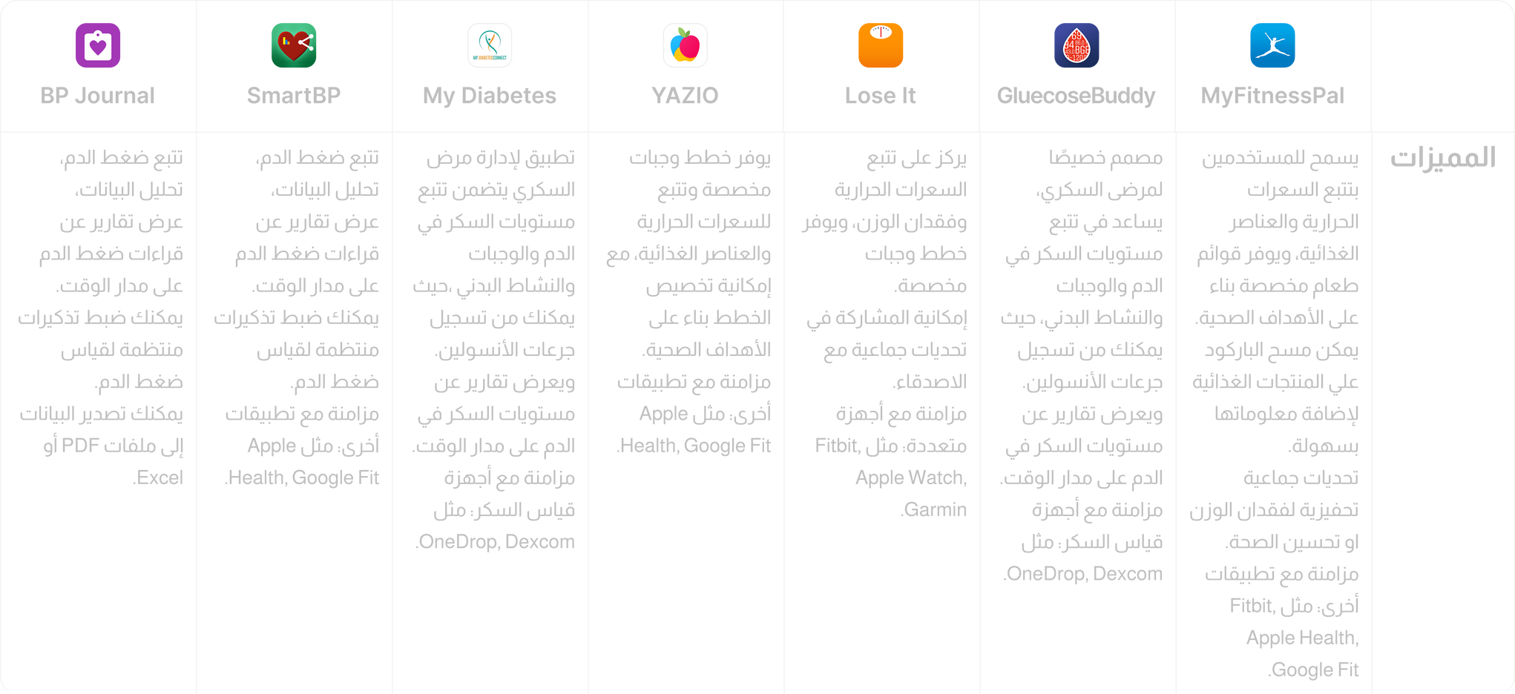
COMPATITOR ANALYSIS

Slide 9
INTERVIEW QUESTION
1. What types of food do you prefer? Do you follow a specific diet or eat randomly?
2. Do you use your mobile phone more or your laptop? And if you had to choose, would you prefer a mobile app or a website?
3. Do you use your mobile phone more or your laptop? And if you had to choose, would you prefer a mobile app or a website?
4. Do you exercise? If yes, what activities do you prefer? If no, are you thinking of starting?
5. What type of insulin do you use, and how do you manage its doses?
6. Do you face any challenges in maintaining stable sugar levels with insulin use?
7. Do you use any devices or apps to monitor your sugar levels and insulin doses?
8. What type of diabetes do you have?

Slide 10
SURVEY

Slide 11
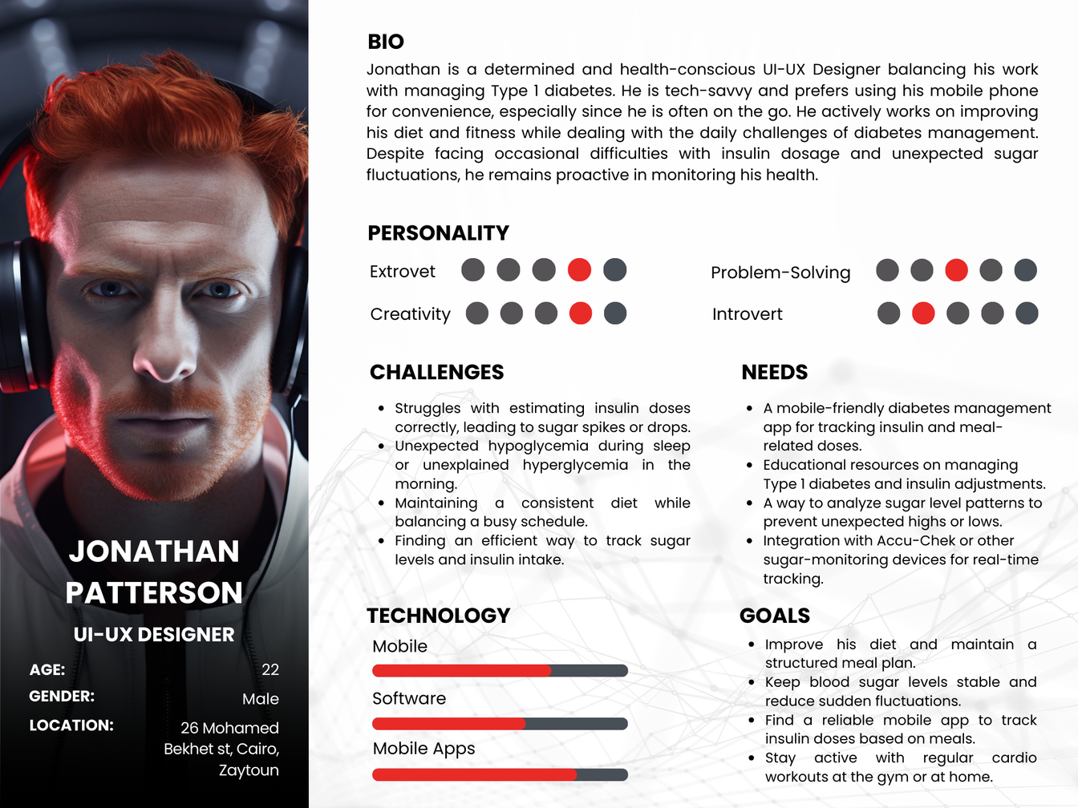
PERSONA

Slide 12
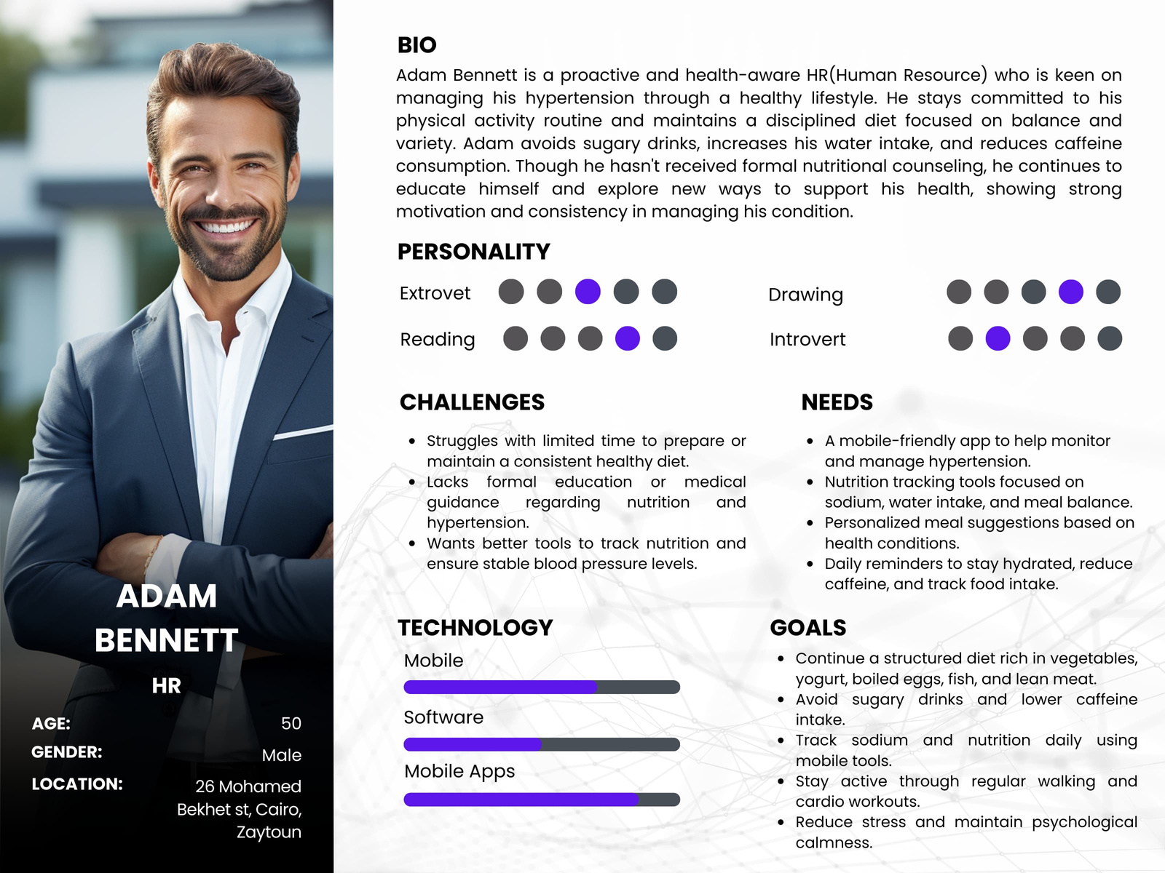
PERSONA

Slide 13
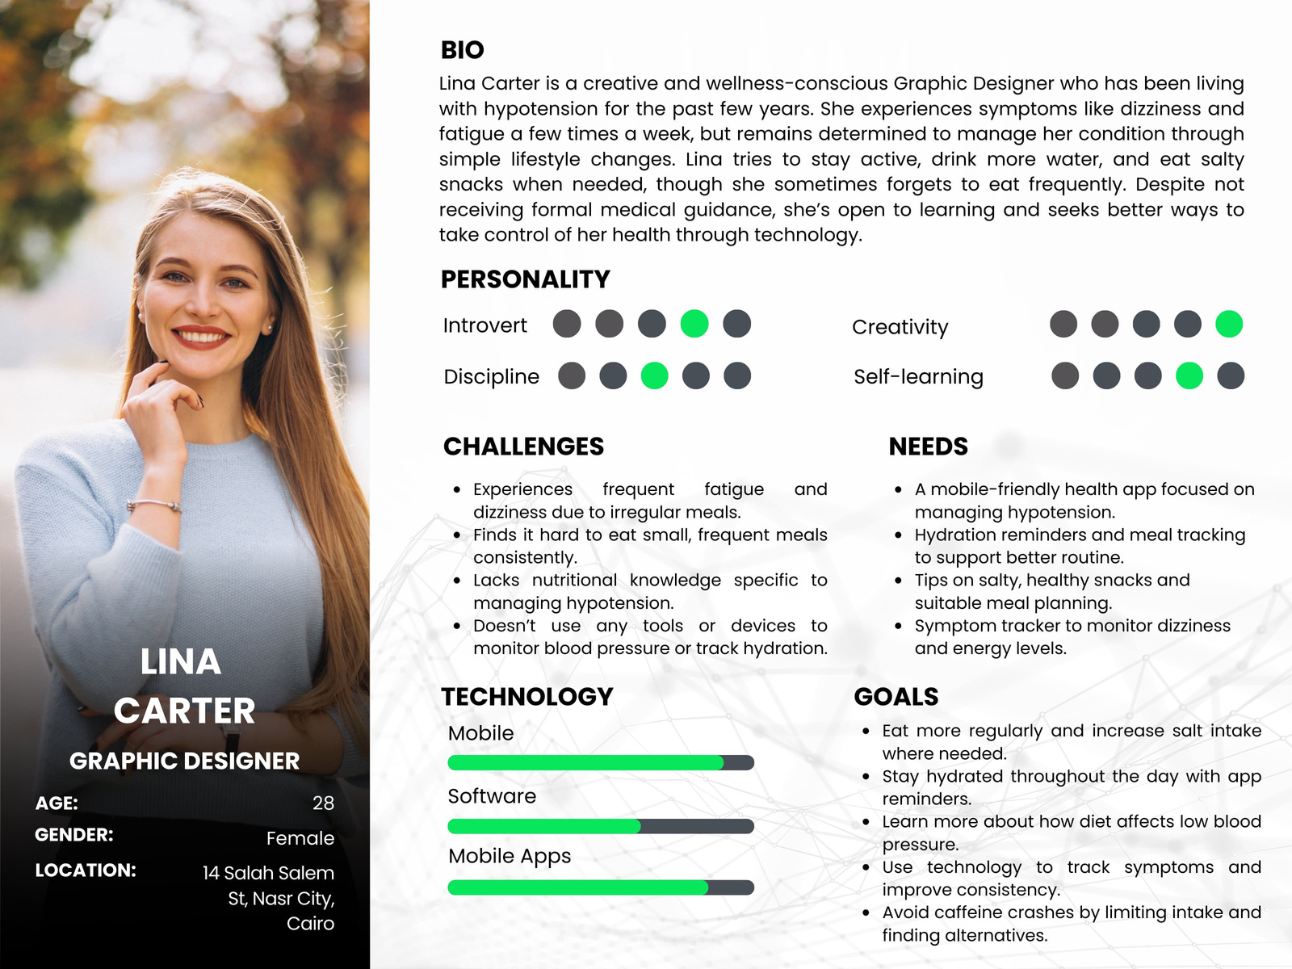
PERSONA

Slide 14
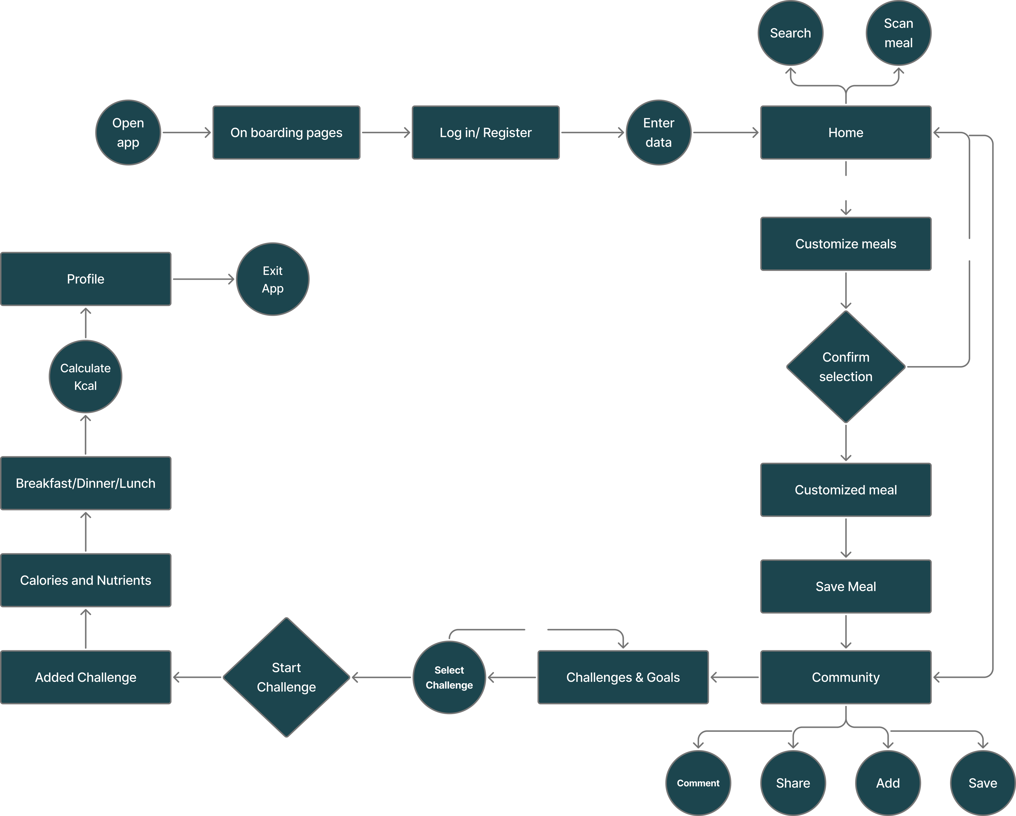
USERFLOW

Slide 15
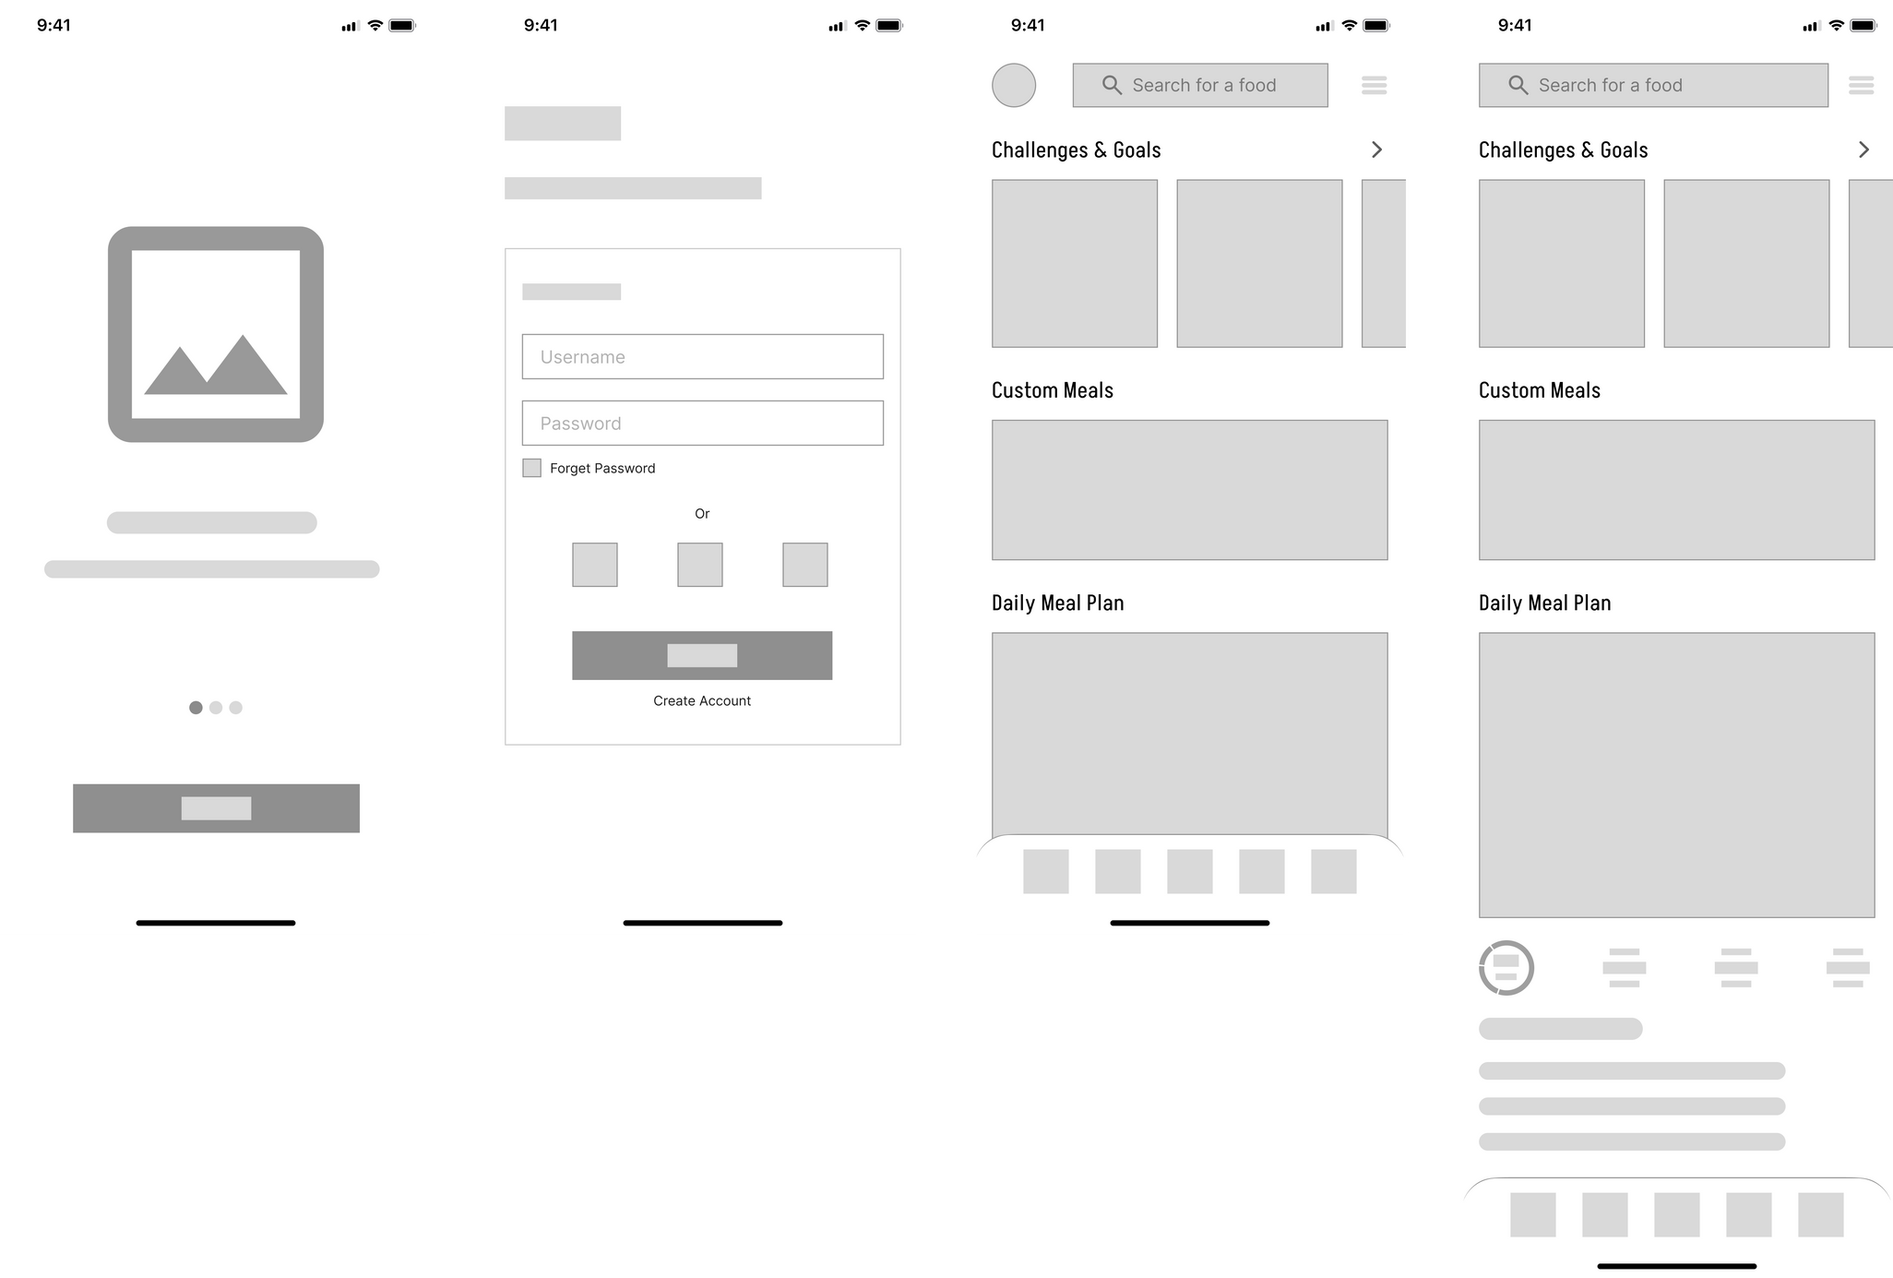
WIREFRAMES
ON BOARDING PAGE
REGISTER
HOME
HOME-EXTENDED
Here are the onboarding screens, followed by the login screen, and then the main screen, where a daily plan is suggested based on dietary preferences. The user can edit it or change one or more ingredients, as well as view nutritional or fitness challenges.

Slide 16
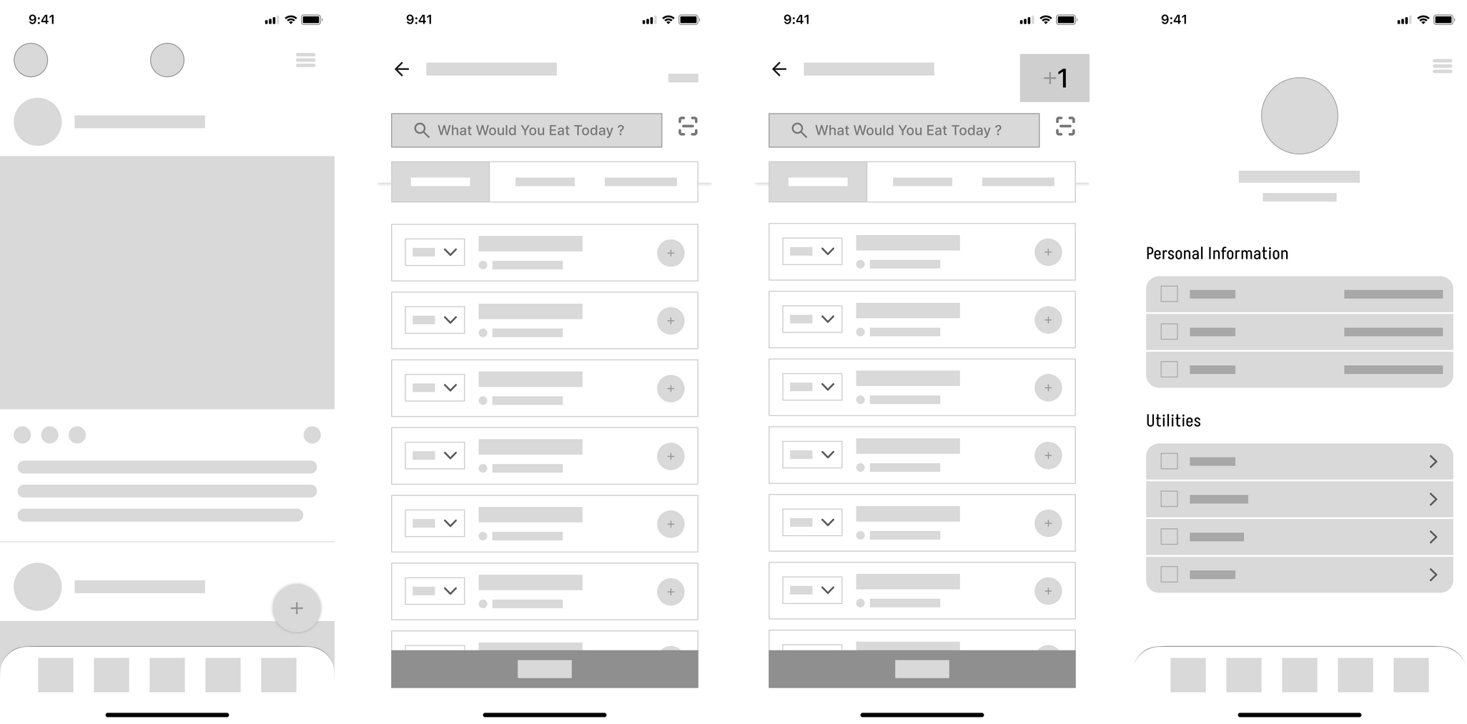
WIREFRAMES
COMMUNITY
CALORIES AND NUTRIENTS
CALORIES AND NUTRIENTS`
PROFILE
Here are the community screens, where the user can share their daily meals, interact with and comment on others' posts, and track their calorie intake by easily logging each meal. There's also a profile screen where they can access saved meals and more.

Slide 17
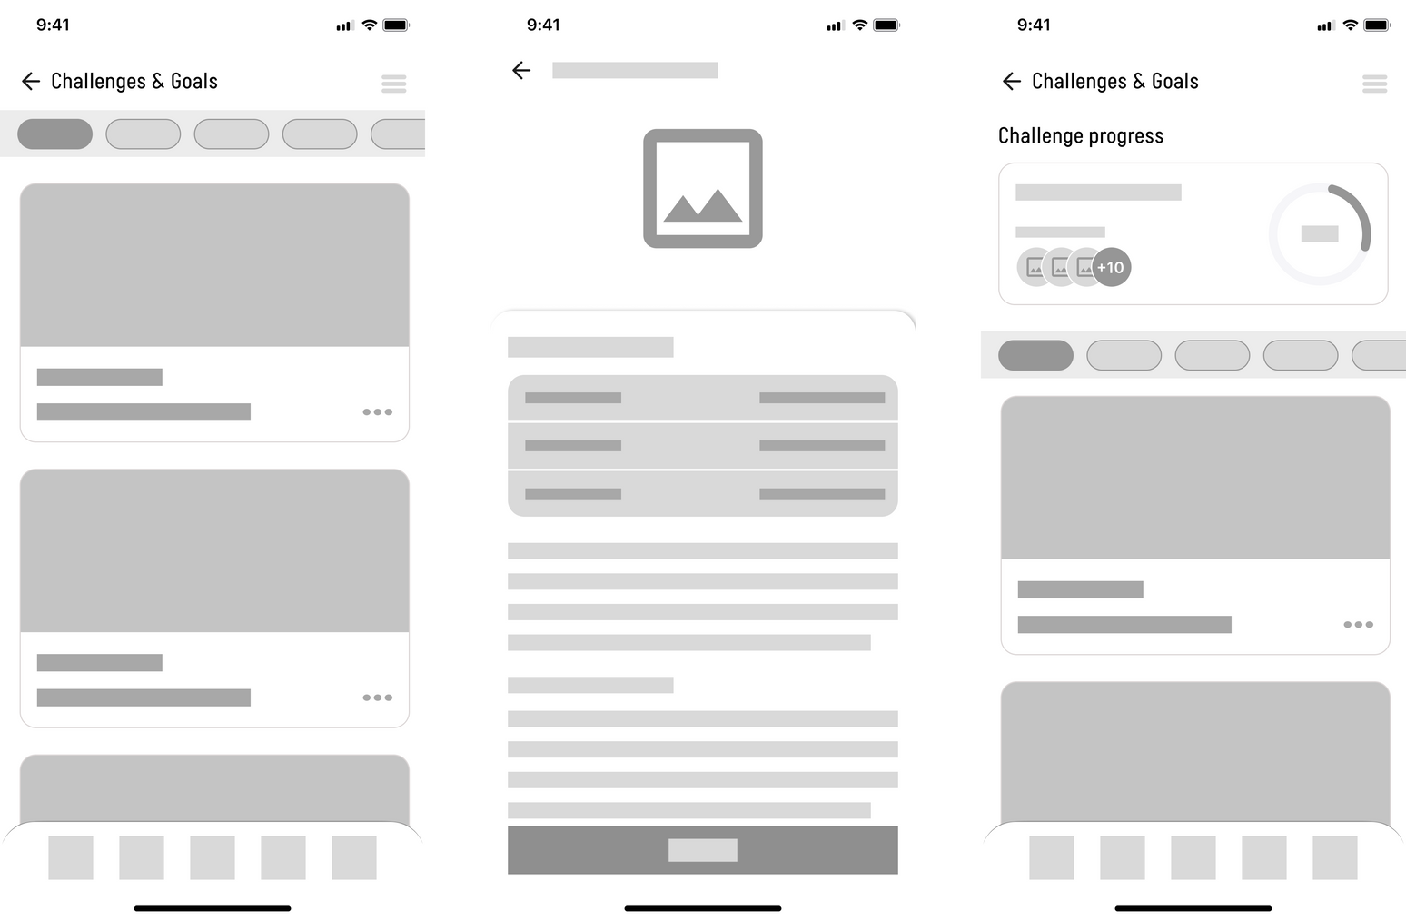
WIREFRAMES
CHALLENGES & GOALS
CHALLENGE DETAILS
CHALLENGES & GOALS
Here are the challenge screens, where the user can choose a challenge to participate in, view the participants, and track their progress.

Slide 18
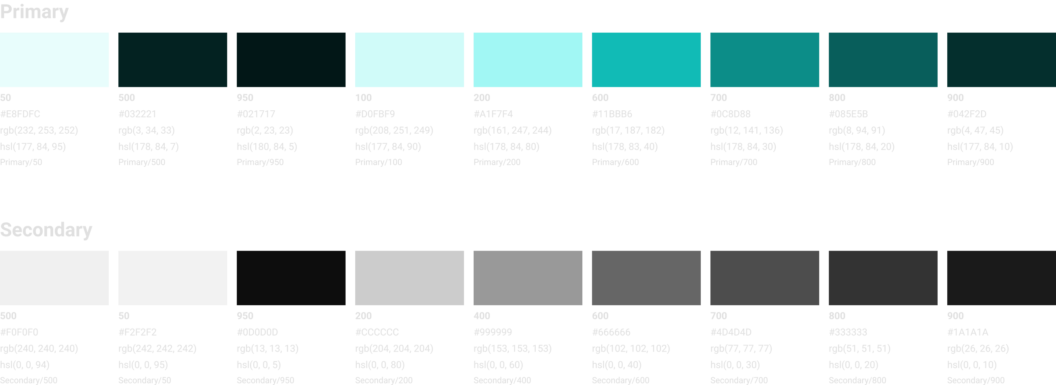
STYLEGUIDE
1- Colors

Slide 19
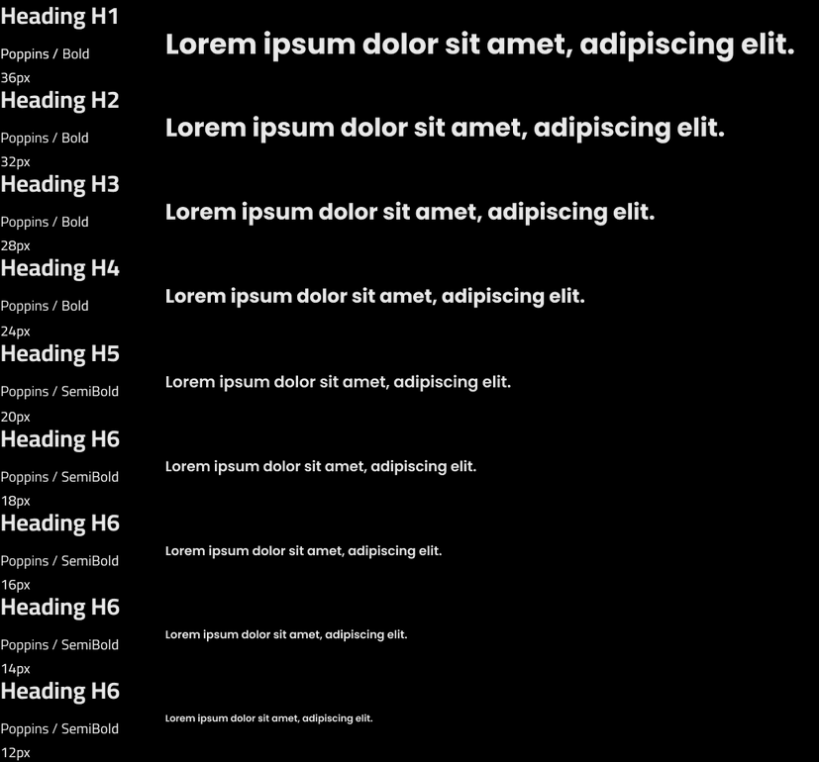
STYLEGUIDE
1- Typography

Slide 20
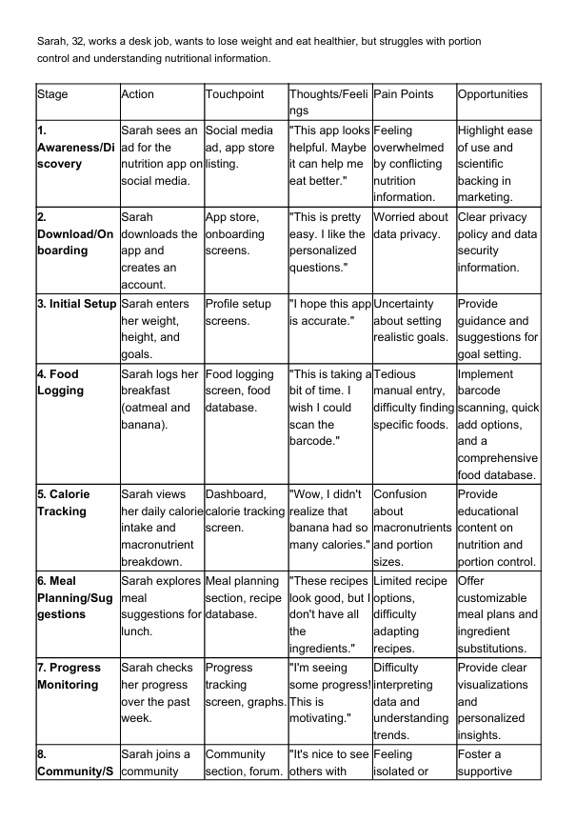
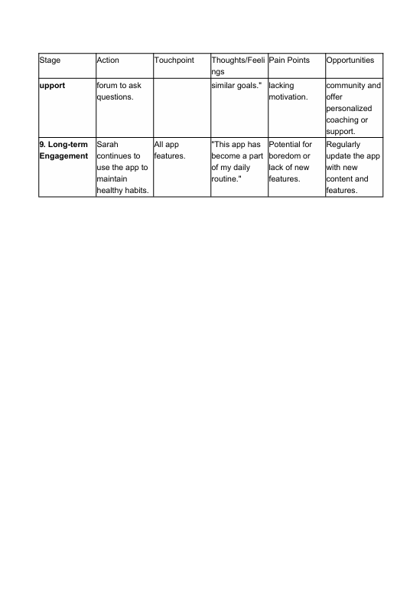
USERJOURNEY

Slide 21
THANK YOU!

